Slide 1
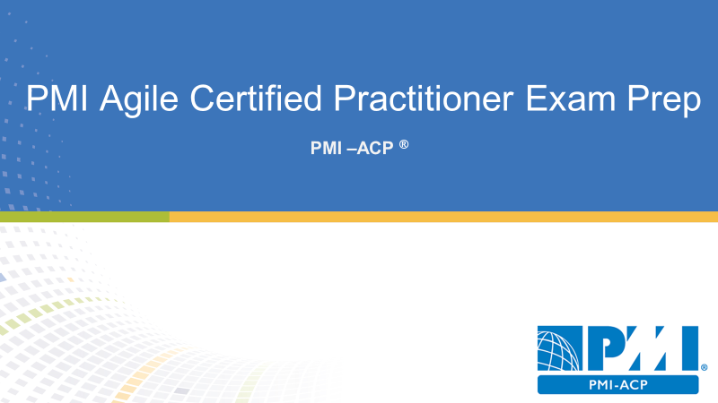
Domain II Value Driven Delivery
20 % of PMI-ACP Exam
24 Questions

Slide 2

Agenda
Value Driven Delivery
Assessing values in Agile Projects
Prioritizing Values in Agile Projects
Incremental Delivery
Contracting in Agile Projects
Value, Verification & Validation

Slide 3
Value Driven Delivery
Maximizing business value through prior authorization incremental delivery testing and validation

Slide 4
Value Driven Delivery Tasks
Plan work incrementally
Gain consensus on just in time acceptance criteria
Tune process to organization team and project
Release minimal viable product
Work in small batches
Review often
Prioritize work

Slide 5
Value Driven Delivery Tasks
Refactor code often
Optimize environmental operational it infrastructure factors
Review and checkpoint often
Balance value and risk
Reprioritize to maximize value
Prioritize nonfunctional requirements
Review and improve the overall process and product

Slide 6
What is Value Driven Delivery?
Projects exist to create business value
The project manager’s goal is to increase value and reduce risk as early as possible
Value-driven delivery has the most weight of the business existence

Slide 7
Deliver Value Early in the Project
Based on prior translation value is delivered first
The longer a project lasts the more opportunity for risk
By delivering high-value items early, the team demonstrates an understanding of the customers needs
Early value help stakeholders maintain synergy an interest in the project

Slide 8
Minimize waste is a constant goal
Waste reduces value
Poppendieck’s Seven Areas of Waste:
Partially done work
Extra processes
Extra features
Task switching
Waiting
Motion
Defects

Slide 9
Assessing Values in Agile Projects
Value is Expressed in Financial Terms

Slide 10
Return of Investment (ROI)
Return on investment is the profitability in a project
Return on investment is the value of the project minus the investment in the project
A higher return on investment means you are getting a better return then a lower return –bigger is better
Return on investment is not the best approach to discovering business value in a project

Slide 11
Present Value
The calculation of a future amount in today’s terms given and assumed interest rate and inflation rate

Slide 12
Net Present Value
The present value of a revenue stream over a series of time periods
Higher net present values are good

Slide 13
Internal Rate of Return
Calculates the NPV of the cost of the project and when the NPV of the project meets or exceeds the NPV of the benefits of the project
The higher the IRR the more valuable the project is

Slide 14
Earned Value Management for Agile Projects
It’s unlikely you’ll see earned value management on the exam
EVM is a suite of formulas to show performance
Earned value compared to actual performance to planned performance

Slide 15
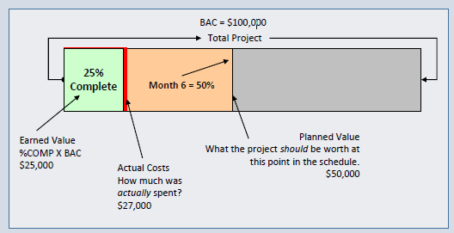
EVM Foundation
Consider a scenario
BAC = $100,000 for the entire project
As of now EV = $25,000 , AC=$27,000 PV=$50,000

Slide 16
EVM Foundation
Finding the variance
Cost Variance = EV-AC = 25,000-27,000 = -2,000
Planned Variance= EV-PV = 25,000-50,000 = -25,000
Measuring the performance
Cost Per Index = 25,000/27,000 = .93
Schedule Per Index = 25,000/50,000 = .50

Slide 17
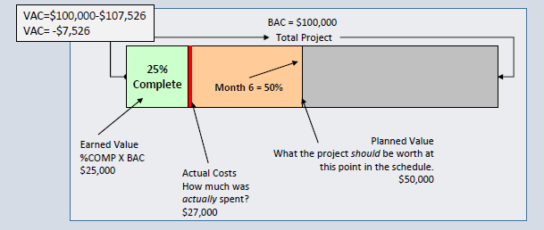
Predicting the Future
Estimate at completion EAC = BAC / CPI EAC=$100,000/.93 =$107,526
Estimate to Complete ETC= EAC – AC = ETC=$107,526-$27,000 =$80,526

Slide 18
EAC in Action

Slide 19
To Complete Performance Index
Efficiency needed to meet BAC: TCPI=(BAC-EV)/(BAC-AC)
TCPI=($100,000-$25,000)/($100,000-$27,000) = 75,000/73,000 =1.0273
Efficiency needed to meet EAC:TCPI=(BAC-EV)/(EAC-AC)
TCPI=($100,000-$25,000)/($107,526-$27,000) =75,000/80,526 =.93
Note:-
Great than 1, hard to accomplish \
Exactly 1, same level of efficiency \
Less than 1, easier to accomplish

Slide 20
Story Points and EVM
Can use Story Points instead of dollars
Planned to complete 20 story points
Completed 18 instead
SPI=EV/PV =18/20 =.90

Slide 21
5 EVM Rules
EV is first
Variance means subtract
Index means division
Less than one is bad in an index
Negative is bad in a variance

Slide 22
What is Agile Project Accounting?
Agile accounting defines the economic models of agile projects
Project work and smaller chunks of a larger project
Smaller chunks of work are less risky
Agile project accounting is accountability of what was invested in relation to the value of the return on investment

Slide 23
Key Performance Indicators
Key performance indicators are metrics to show how well the project is performing
Rate of progress
Remaining work
Likely completion date
Likely cost remaining

Slide 24
Managing Risk in an Agile Projects
Risk in an agile project is anything that threatens the project’s goals
Risk is considered an anti value
Risk must be managed in a project
Risk identification is an iterative activity
Risk a recorded in a risk along

Slide 25
Addressing features with high risk
Features that have high levels of risk can be addressed early in project iteration
High areas of risk need to be addressed sooner rather than later
A risk-adjusted backlog brings risk features into an early portion of the project
A risk burndown chart tracks risk as they move down in priority and elimination

Slide 26
Regulatory compliance for Agile Projects
Regulations are requirements
Regulatory compliance is one instance for documentation where just because is utilized

Slide 27
Prioritizing Values in Agile Projects
Welcoming Changing requirements is the key to Agile Projects

Slide 28
Customer Value Prioritization
Agile teams work on the items that yield the highest value to the customer first
The product owner is responsible for keeping items in the backlog prioritized by business value
When changes added to backlog, they must be prioritized for value
The customer is the person who will declare what success looks like
The team will discuss with the customer at the end of each iteration the priority of the remaining work items

Slide 29
Prioritization Schemes
How the work is prioritized
The team agrees on the prioritization scheme
The prioritization scheme is communicated and agreed upon by the entire agile team

Slide 30
Simple Scheme for Prioritization
Items in the product backlog are ranked:
Priority one (high)
Priority two (medium)
Priority three (low)
This approach has a risk that everything is ranked as priority one

Slide 31
MoSCoW Prioritization Scheme
Made popular by DSDM
Must have
Should have
Could have
Would like to have, but not at this time

Slide 32
Monopoly Money
Stakeholders receive monopoly money equal to the amount of the project budget
The monopoly money is distributed among the system features
This approach is most effective when it’s limited to prioritizing business features

Slide 33
100 Point Method
Each stakeholder is allotted 100 points
The points are assigned to the most important requirements

Slide 34
Dot Voting or Multi Voting
Stakeholders gets a predetermined amount of dots
Dots are assigned to the business features
Dots could be check marks or stickers

Slide 35
Kano Analysis
Delighters exciters
Satisfiers
Dissatisfiers
Indifferent

Slide 36
Requirements @ Prioritization Level
Uses a scale of 1 to 9
Benefit penalty cost and risk of every feature is rated

Slide 37
Relative Prioritization Ranking
Priority of features
Simplest the features from most important to least important
Determination made to meet budget and schedule
Changes may change the prioritize list
Changes may bump some priorities from the list

Slide 38
Incremental Delivery
Optimizing the value of delivery

Slide 39
Incremental Delivery
The team regularly deploys working increments
Usually to a test environment for evaluation
This is an opportunity for an early return on investment

Slide 40
Minimum Viable Product
Complete enough to be useful
•Small enough that it does not represent the entire project
•Also known as the minimal marketable feature
•Barebones essentials of a product

Slide 41
Agile Tooling
Agile teams prefer low-tech high-touch tools over-sophisticated computerized models
Technical tools can exclude team members from interacting
Consider high-tech tools for scheduling:
Data accuracy perception increases
A bad estimate is a bad estimate
Barriers for stakeholder interaction are created

Slide 42
Examples of Low-tech High-touch Tools
Cards
Charts
Information radiator
Tools that promote communication and collaboration
Tools that promote learning and knowledge transfer

Slide 44
Scheduling Software Vs Kanban Board
Also known as a task board
Help teams monitor the work in progress

Slide 45
Work In Progress
Also known as a work in process and work in play
WIP is risk
WIP hides bottlenecks
WIP requires investment but delivers no return until the work is complete
WIP needs to be limited

Slide 46
Limiting Work In Progress
Agile attempts to limit WIP
Kanban boards can have WIP limits
WIP limits keeps the team from taking on too many pieces of work
WIP limits reveal bottlenecks

Slide 47
Cumulative Flow Diagram
Cumulative flow diagrams help tracking and forecasting the delivery of value
Reveals the total in progress and completed work

Slide 48
Bottlenecks & Theory of constraints
A constraint is anything that limits your options
Time, cost, and scope are typical constraints
Constraints can be throughput of capacity
A thin line in a cumulative flow diagram can reveal a bottleneck

Slide 49
Goldratt’s Theory Of Constraints
Five Focusing Steps Of Goldratt’s Theory Of Constraints
Identify the constraint
Exploit the constraint
Subordinate all other processes to exploit the constraint
If after steps two and three is done more capacity is needed to meet demand elevate the constraint
If the constraint has not moved go back to step 1

Slide 50
Contracting Agile Projects
Exploring Agile Project Contracts

Slide 51
Request for Proposal
A request for proposal is from the buyer to the seller
If the seller is to use a agile practices it must be defined in the request for proposal
The buyer may need to educate the vendor about agile practices
Agile project welcome change so this may be hard to do with contracts

Slide 52
Agile Constraints and Contracts
Agile is flexible
Contracts are not flexible
Contracts are a form of a constraint
Contracts are constrained by an offer and a consideration
Collaboration over contracts
Agile projects constrain time and cost
Agile project allow the scope to change
Contracts typically constrain and balance time cost and scope

Slide 53
Consideration for Contracts
Scope changes
Priorities
Time and cost

Slide 54
Fixed Price Contract
Both parties share some of the risk and reward
If a vendor delivers on-time they get paid for their work at the hourly rate
If the vendor delivers early they get paid for their work but at a higher hourly rate
If the vendor delivers late they get paid for their work but at a lower

Slide 55
Fixed Price Work Packages
The price of the work remains constant
Individual work packages are estimated for cost
Changes to the scope reflect a new estimate for those work packages

Slide 56
Customize Contracts
The buyer and the seller can make any agreement they want
Procurement is always tricky with agile projects

Slide 57
Value, Verification & Validation
Ensuring Value with Agile Projects

Slide 58
Gulf of Evaluation
The difference between what is said and what is understood
Intangible projects often experience this gulf
What does done looks like?

Slide 59
Frequent Verification and Validation
Testing checkpoints and reviews
Frequent verification and validation happened throughout the project
Build consensus between the project team and the project stakeholders

Slide 60
Examples of Verification and Validation in XP
Pair programming
Unit testing
Customer collaboration
Stand up meetings
Acceptance testing
Iteration demonstrations
Product release

Slide 61
Exploratory Testing
The tester aims to discover issues and unexpected behavior
The tester explores the software
This is in addition to scripted testing

Slide 62
Usability Testing
How will a user respond to the system under realistic conditions?
How easy is it to use the system?
What improvements need to be made for usability?

Slide 63
Continuous Integration in Agile Projects
Incorporate new and changed code into the code repository
Small code commits
Frequent integration
Relies on automated tools to integrate code when new code is checked in

Slide 64
Continuous Integration System
Source code control system –version control
Build tools –build tools compile the code
Test tools –unit test to ensure functionality operates as expected
Scheduler or trigger –builds are launched on a schedule or based on conditions
Notifications –an email or instant message reporting on the results of a build

Slide 65
Why Continuous Integration?
Early warning a broken conflicting or incompatible code
Problems are fixed as they occur
Immediate feedback
Frequent unit testing define issues quickly
Easy to reverse the code back to the last known good

Slide 66
Disadvantages of Continuous Integration
Set up time is lengthy
Often called Iteration 0
Cost of a dedicated server
Time required to build a suite of automatic tests

Slide 67
Exploring Test Driven Development
Also called test first development
•Test are written before the code is written
Nunit
Junit
•Code is developed and edited until the code passes all tests
•Refactoring is the final step to clean up the code

Slide 68
Test Driven Development
Red –green –re-factor
Red –green –clean
Focus on the test first
Early testing helps catch defects early in development
Beware of developers writing their own test

Slide 69
Acceptance Test Driven Development
Testing focus is on business requirements
Test represent the functionality the software is to have
It’s all about the desired behavior
FIT –framework for integrated testing
Also called FitNessee
http://www.fitnesse.org/

Slide 70
Acceptance Test Driven Development Cycle
Discuss the requirements –developers as the product owner questions that are designed to gather acceptance criteria
Distill test in a framework friendly format –gets the test ready to be entered into the acceptance test tool
Developed the code and run the test –test initially fail because the code hasn’t been written completely
Demo –with automated acceptance testing scrips and demonstrations of the software

Slide 71

Domain Completion
PMI-ACP
You have successfully completed –
Value Domain Delivery domain

